Slide 1




Outbox Pattern
When simple API call is not enough
Jacek Milewski
jacek.milewski.k@gmail.com
@jacek_mil

Slide 2

1. The problem 2. The Outbox pattern 3. Implementation 4. Testing 5. Concerns
Agenda
@jacek_mil

Slide 3
The problem
@jacek_mil

Slide 4
The problem
HTTP
@jacek_mil

Slide 5


Details
save it in db
and
post a request to external api
@jacek_mil

Slide 6
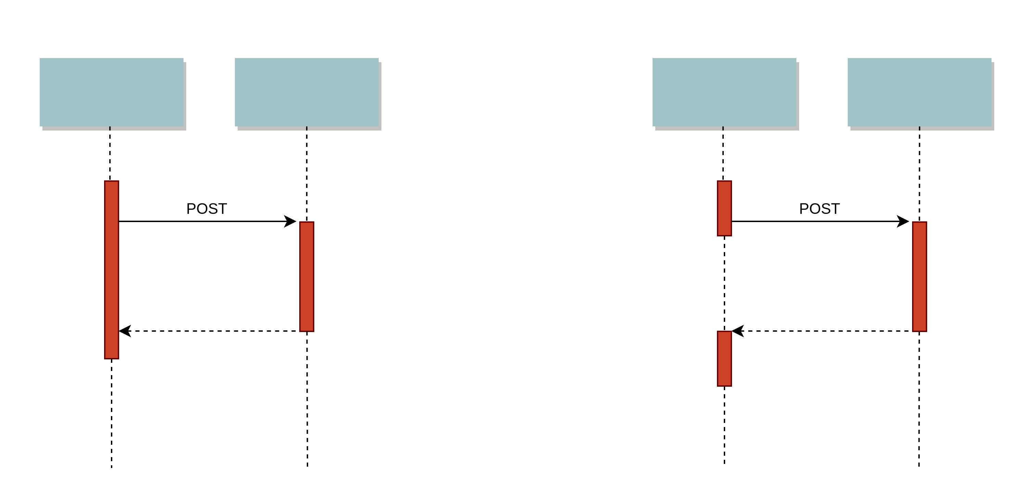
Sync? Async?
@jacek_mil

Slide 7
Sync? Async?
 | Sync | async
consistency | Immediate | eventual
Implementation effort | Small | Complex
Processing time | Slower | Same but split to steps
Handling errors / rollbacks | Explicit error responses | Reconciliation needed
Retry mechanism | None | Simpler, depending on a tools
@jacek_mil

Slide 8
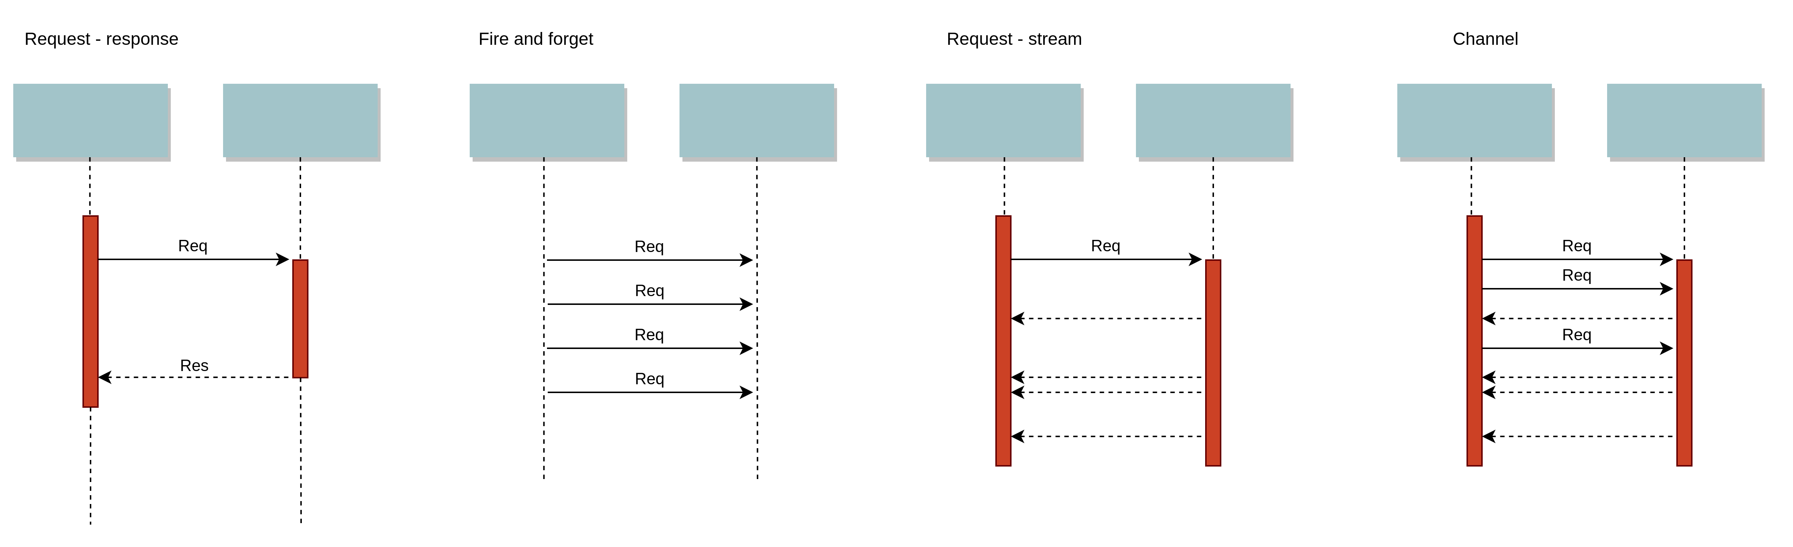
STYLES OF COMMUNICATION
@jacek_mil

Slide 9
Consistency when being Async
Broadcast
Broadcasting an event
Accepting lost messages
Transactional?
Can it be rejected?
How to rollback?
Compensating action
Expecting Response?
Fire and forget
Request – response?
Delivery guarantee
At least once
At most once
Exactly once
Delivery order
Can be guaranteed on producer side
@jacek_mil

Slide 10
Outbox pattern
@jacek_mil

Slide 11
Sync
@jacek_mil

Slide 12
Naive aSync
@jacek_mil

Slide 13
Outbox
@jacek_mil

Slide 14
Outbox
 | async
consistency | eventual
Implementation effort | Complex
Processing time | Same but split to steps
Handling errors / rollbacks | Reconciliation needed
Retry mechanism | Simpler, depending on a tools
@jacek_mil

Slide 15
Outbox with queue
@jacek_mil

Slide 16
Is the queue needed?
Handles retries
DLQ Mechanism
Offloads DB transactions
When API requests are slow
Reduces the outbox table size
Adds complexity
@jacek_mil

Slide 17
The IDEA
Write in db, other thread is reading (graphic)
Show where transaction boundaries are, where they are lost
Saving in DB and putting in queue is a distributed transaction, do you want to add msg to queue within SQS transaction?

Slide 18
What does it serve
Async
Must be consistent, can be eventually consistent
Request – response
With response is handled asynchronously
Distributed transaction replacement
At least once delivery
@jacek_mil

Slide 19
Outbox Use cases
User signup creates a user in system A but also creates a record in system B
Unavailability of B should not prevent nor slow down the signup process in A
Add a sequence diagram?
User action publishes an event in reporting system (via API, queue, etc...)

Slide 20
Outbox Events Processing
Implementation how-to
@jacek_mil

Slide 21
Saving to outbox
Within business transaction
Include all details needed at later steps
Order
Unordered
Global order
Local order
@jacek_mil
Notes:
Order of items in the outbox
when two instances have a clock drift, then two created items might lose order in Database
The solution is:
add sequence column, with incremented number created by database
created column should be filled by a database, not by app instances
Order of delivery
Keep things idempotent
Or use tools to make it https://sookocheff.com/post/messaging/dissecting-sqs-fifo-queues/
https://edu.devstyle.pl/products/droga-nowoczesnego-architekta/categories/3088156/posts/10288754 18:00

Slide 22
Reading outbox
Periodically
Shedlock, quartz, cron
Reader on single instance in multi instance environment
choose reading interval
After transaction commit
Reducing delay
By a separate thread
@jacek_mil

Slide 23
Saving to queue
Each Outbox event processed in a separate transaction
Mind the ordering
Offload DB from heavy processing
After ACK:
remove from outbox
or update its status
@jacek_mil

Slide 24
Queue config
fifo
content based deduplication
Visibility timeout: 60s
Max receive count: 10
@jacek_mil

Slide 25
Reading queue
Order
Multiple threads might break the order
Retry mechanism on failed processing
Message comes back to queue with visibility timeout
When failed after max retries, goes to DLQ
Dead Letter Queue
DLQ events are monitored
DLQ subscriber notifies Customer Care on manual intervention required
When API responds with our error (4xx)
Message lands in DLQ directly
@jacek_mil

Slide 26
Testing
Implementation how-to
@jacek_mil

Slide 27
Integration tests
HTTP Client
DB
+
SQS LocalStack
Trigger Outbox Manually
Wiremock
+
Awaitility
@jacek_mil

Slide 28
Unit testing
Testing business and proces logic
Not very specific to outbox
@jacek_mil

Slide 29
Cross cutting concerns
@jacek_mil

Slide 30
Outbox database
Use same DB as your production DB
SQL
Event is stored as a jsonb type in psql
NoSQL
Transactions are different but the idea of consistency is the same
@jacek_mil

Slide 31
Versioning events
Outbox and Queue event is a contract
old app version might not be able to process new version
When changing the contract
Do backward compatible changes
Versioning in events
{
name: "Jacek"
}
{
name: "Jacek",
status: "BLOCK"
}
@jacek_mil

Slide 32
Poisoning message
Broken Message at the head of the queue
Ensure it does not block the whole processing, but just itself
Ignore error and continue
Might happen when:
Breaking event syntax compatibility: Postpone it
Bug: Drop it to DLQ
@jacek_mil

Slide 33
Observability
Logging all proces steps
Monitoring the metrics
Tracing all steps
TraceId is persisted through the whole processing
@jacek_mil

Slide 34
Retry mechanism
At least once delivery
in two flavors:
Retry reading from outbox
retry with visibility timeout on SQS
@jacek_mil

Slide 35
At least once delivery
Delivery guaranteed on each step
Event is deleted only after ACK is received
Duplication happens when:
ACK was lost
Delete failed
On Sprint Demo
@jacek_mil

Slide 36
Order
Ordering needs special treatment in async communication
How strict order is required?
Unordered
Global order
Local order
Order of delivery or a presentation order
Events need to have sequence or timestamp
Sourced from central source of truth, e.g. Database
Reading from outbox and SQS honors the order
One thread at a time can read outbox and process events in an ordering boundaries
@jacek_mil

Slide 37
Data export scenario
CSV + delta [cassie]
Outbox mechanism sync job [Okta]
Notes:
First: export big CSV, then store events in outbox to free them out later
Or ignore CSV, when some output (Okta ID) is needed. Just use sync user creation by scheduled job

Slide 38
Thank you!
Outbox Pattern:
When simple API call is not enough
Jacek Milewski
jacek.milewski.k@gmail.com
@jacek_mil

